Slide 1
Survey of Cloud Computing and Azure Foundation
Module 1, Lesson 3:
Services in Azure

Slide 2
Topics
What is Microsoft Azure?
Virtual Machines
Cloud Services
App Service
Modules of Azure Service
What is the Azure Portal?

Slide 3
Objectives
By the end of this lesson you should be able to:
Explain the types of services offered and deployment models available in Azure
Understand Azure portal services and key capabilities

Slide 4
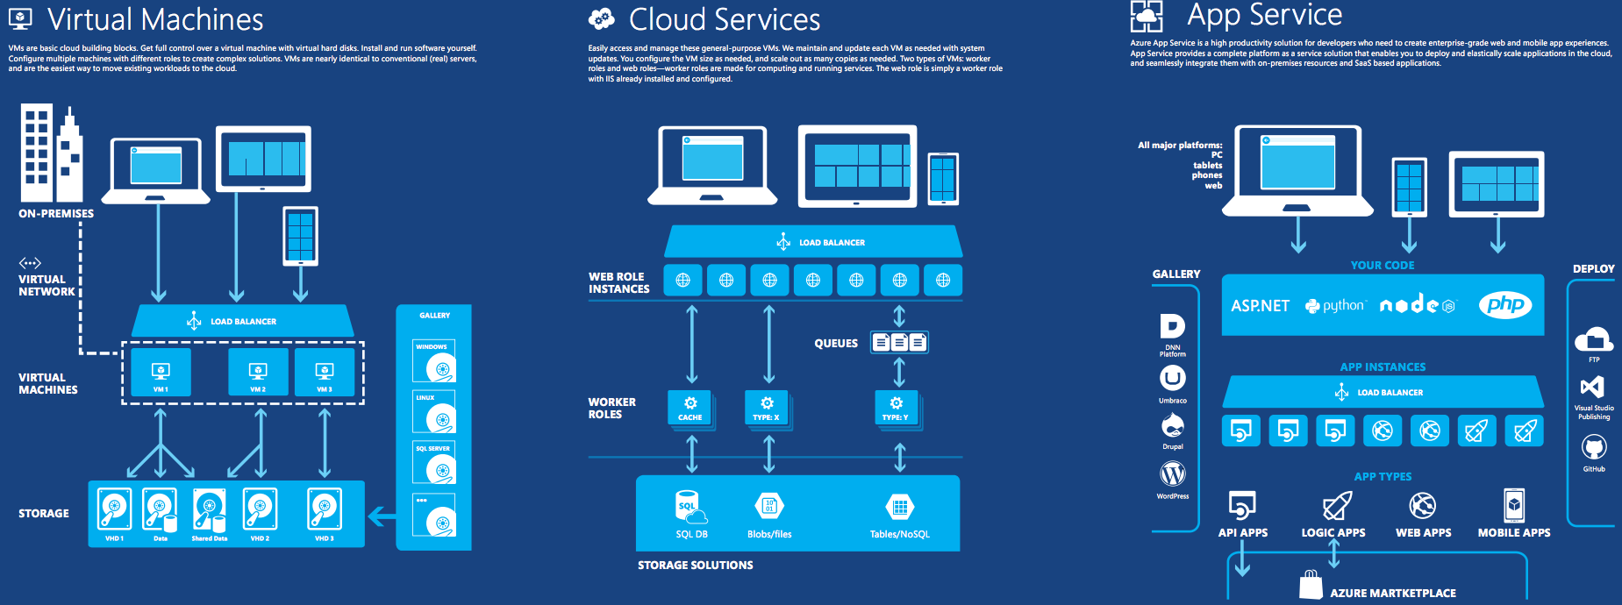
What is Microsoft Azure?
Azure is a flexible, open, and secure public cloud built for business.
Notes:
Notes:
Azure provides different hosting modes for running applications. Each provides a different set of services.
This is a header slide to show overall architecture of the various Azure services. Each of these service areas will be covered in detail in following slides.
References:
https://azure.microsoft.com/en-us/documentation/infographics/azure/

Slide 5
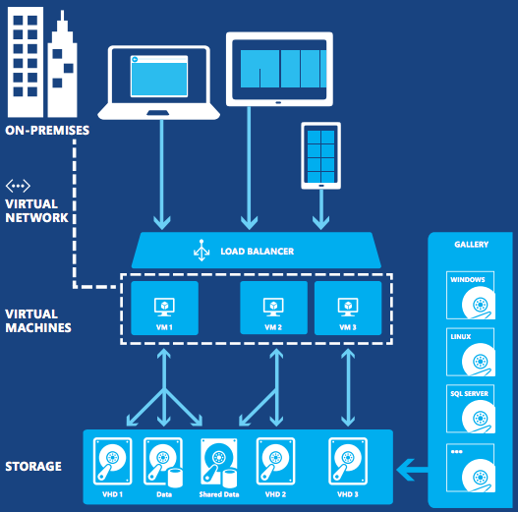
Virtual Machines
Basic cloud building blocks
Full control over virtual machines
Install and run user applications
Gallery of VM images available
Notes:
Notes:
Azure provides different hosting modes for running applications. Each provides a different set of services.
VMs are basic cloud building blocks. Full control over a virtual machine can be obtained with virtual hard disks. Users are required to install and run their own software applications.
References:
https://azure.microsoft.com/en-us/documentation/infographics/azure/

Slide 6
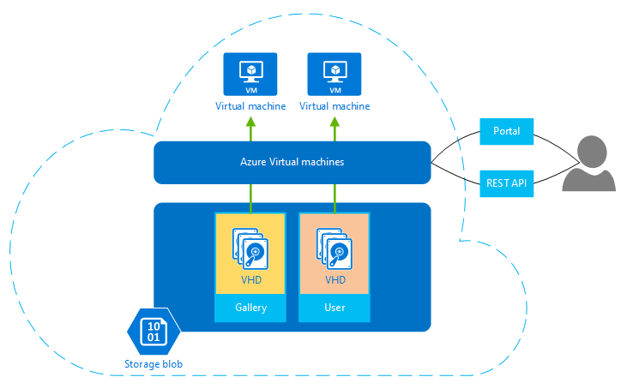
Azure Virtual Machines – IaaS
IaaS Service
VHD (Virtual Hard Disk) for persistent storage
Different types of VMs can be configured together to provide complex solutions
Notes:
Notes:
As an IaaS, Azure Virtual Machine users are responsible for managing much of this environment, including things such as deploying new patched versions of the operating system in each VM.
Azure VMs let you deploy Windows or Linux servers in the cloud. VMs have operating systems, storage, and networking capabilities and can run a wide variety of applications.
VMs use virtual hard disks (VHDs) to store their operating system (OS) and data. Data on VHDs are persistent between sessions and can be used to store images of a desired VM. Azure storage blobs form the actual storage medium for these VHDs.
Users can configure multiple machines with different roles to create complex solutions. VMs are nearly identical to conventional physical servers. VM images can be selected from a marketplace or user can employ their own customized images. Multiple machines can be configured with different roles to create complex solutions.
Examples of VMs :
1. Linux servers such as Suse, Ubuntu, and CentOS
2. Windows Server
3. SQL Server
4. BizTalk Server
5. SharePoint Server
References:
http://www.valorepartners.com/category/infrastructure-services/
Image Source: https://azure.microsoft.com/en-us/documentation/articles/virtual-machines-windows-about/

Slide 7
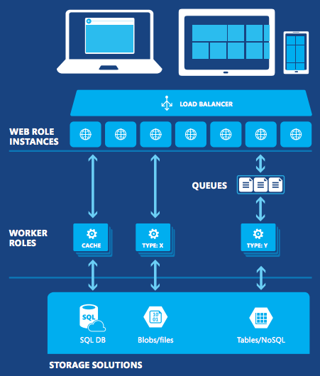
Cloud Service
General purpose VMs available to user
Users configure size of VM to fit their needs
Vendor maintains VM with system update
Notes:
Notes
Azure provides different hosting modes for running applications. Each provides a different set of services.
Cloud services: Access and manage general purpose VMs. Azure maintains and updates each VM as needed with system updates.
Users configure the VM size as needed and scale out as many copies as required.
Web role is simply a worker role with IIS (Internet Information Server) already installed and configured (more detail in next slide).
References:
https://azure.microsoft.com/en-us/documentation/infographics/azure/

Slide 8
Cloud Services - PaaS
Code
PaaS service
More flexibility over VMs than App Services
Multiple worker role and/or web role VMs allowed for single application
Single service access point for application end-user
Config
Cloud
Service
Service
endpoint
Web
roles
Worker
roles
Storage (Azure)
Notes:
Notes:
Cloud services is an example of Platform-as-a-Service(PaaS). Management of the platform itself is handled by the vendor. Users have more control over their VMs than in App Services, such as the ability to install their own development or other software. However, those must be maintained by the user. If these types of customization are not required, App Services are the quickest way to deploy user solutions.
There are two types of VMs in Cloud Services (worker and web role). The worker roles are made for computing and running services without IIS (Internet Information Services). The web role is deployed on Windows server with web applications automatically deployed to IIS. For example, a simple application might use just a web role, while a more complex application might use a web role to handle incoming requests from users, then pass the work for those requests to a worker role for processing using Azure Service Bus or Azure Queues.
All worker role VMs and web roles VMs run in the same cloud service for a single application.
References:
https://azure.microsoft.com/en-us/documentation/articles/cloud-services-choose-me/

Slide 9
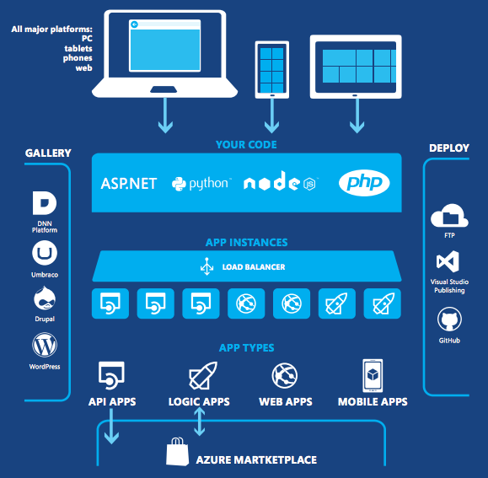
App Service
Features
Multiple languages and frameworks
Global scale with high availability
Connections to SaaS platforms and on-premises data
Security and compliance
Application Templates
DevOps optimization
Notes:
Notes:
App Service provides a complete platform-as-a-service solution that enables users to deploy and elastically scale applications in the cloud and seamlessly integrate them with on-premises resources and SaaS-based applications.
App Service has first-class support for ASP.NET, Node.js, Java, PHP, and Python.
This supports creation of app types such as Web Apps, Mobile Apps, API Apps, and Logic Apps.
Web Apps - Create and deploy mission-critical Web apps that can scale for users’ needs
Mobile Apps - Create mobile apps that can be accessed on any device at any time
API Apps - Build and consume cloud APIs
Logic Apps - Automate the access and use of data across clouds without writing code
References:
https://azure.microsoft.com/en-us/documentation/articles/app-service-web-overview/
https://azure.microsoft.com/en-us/documentation/infographics/azure/

Slide 10
App Service - PaaS
PaaS service
Optimal for quick web and mobile apps development
Popular web apps – Drupal, Wordpress, etc.
Custom web apps – ASP.NET, PHP, Node.js, etc
Integration with SAP, Oracle EBS, SQL Server, and PeopleSoft via BizTalk Services
IIS
Static Websites
Popular Web Applications:
Custom Web Applications:
TFS/GIT
Virtual Machines
HTML
App Services
Code
Web App
Notes:
Notes:
App Service - Platform for developers who need to create enterprise-grade web and mobile app experiences
App Services integrates several Azure services:
Websites (Ref: https://azure.microsoft.com/en-us/documentation/articles/app-service-web-overview/ )
Mobile Services (Ref: https://azure.microsoft.com/en-us/services/app-service/mobile/ )
BizTalk Services (Ref: https://azure.microsoft.com/en-us/services/biztalk-services/ )
SAP – Systems, Applications and Products = Well known ERP (Enterprise Resource Planning) tool
Oracle EBS – Oracle E-Business Suite
TFS – Team Foundation Server = repository for your code
GIT – Github = repository for your code
References:
https://azure.microsoft.com/en-us/documentation/articles/app-service-web-overview/

Slide 11
Why App Service - Web Apps?
Services optimized to rapidly build, deploy and manage enterprise grade websites
Jump-start using large list of existing templates
Automatically scale depending on usage and traffic
Integration and versioning with Visual Studio Team system, Github, TeamCity, Hudson or BitBucket
Tools for staged deployment and verification
Easy connection and access to on-premises data
Web Apps
Notes:
Notes:
With Web Apps Gallery, users can select from an ever-growing list of existing web application templates. They are able to leverage the best of the open-source Software (OSS) app community with one-click installation of packages such as Wordpress, Joomla, and Drupal.
Auto-scaling in Web Apps enables organizations to quickly scale up or out to handle any incoming customer load. Users can manually select the number and size of VMs or set up auto-scaling to scale their servers based on load or schedule.
Continuous Integration allows organizations to set up continuous integration and deployment workflows with Visual Studio Team System (VSTS), GitHub, TeamCity, Hudson or BitBucket . This enables them to automatically build, test, and deploy web apps on each successful code check-in or integration test.
Using deployment slots allows developers to implement staged deployment to verify code in a pre-production environment which is identical to their production web app in Azure App Service.
References:
https://azure.microsoft.com/en-us/services/app-service/web/

Slide 12
Other Options
Azure also offers other compute hosting models for more specialized purposes
Model | Description
Mobile | Optimized to provide a cloud back-end for apps that run on mobile devices.
Batch | Optimized for processing large volumes of similar tasks, ideally workloads which lend themselves to running as parallel tasks on multiple computers.
HDInsight (Hadoop) | Optimized for running MapReduce jobs on Hadoop
Notes:
Notes:
Batch helps users run large-scale parallel and HPC (high-performance computing) applications efficiently in the cloud. It's a platform service that provides job scheduling and autoscaling of a managed collection of virtual machines to run the jobs.
In HDInsight, users can work with big data in the cloud by using Hadoop, HBase, Apache Storm, and customized clusters.
Several of these will be discussed later in the module.

Slide 13
Azure Service Modules - 1
Azure provides a broad collection of integrated services
Compute | Web and Mobile | Data and Storage | Analytics
Virtual Machines Cloud Services Batch RemoteApp Service Fabric Azure Container Service | App Service Logic Apps Web Apps Mobile Services API Management Mobile Engagement | DocumentDB SQL Database Redis Cache Storage StorSimple Search SQL Data Warehouse SQL Server Stretch Database | HDInsight Machine Learning Data Factory Data Catalog Data Lake Store Data Lake Analytics
Notes:
Notes:
In Azure Compute service,
Provision Linux VM and SQL Server, SharePoint and more Windows virtual machines. It creates highly available, infinitely scalable cloud application and APIs.
It can run large-scale parallel and batch compute jobs. Azure RemoteApp allows end-users to access apps on a variety of devices—Windows, Mac OS X, iOS, or Android.
It uses open source tools to deploy and manage containers.
In Web and mobile service, it creates web and mobile apps for any platform and device. Azure Mobile Services is a scalable cloud backend for building Windows Store, Windows Phone, Apple iOS, Android, and HTML/JavaScript applications. Developers can store data in the cloud, authenticate users, and send push notifications to their application within minutes.
Azure API Management allows for publishing of APIs to developers, partners, and employees securely and at scale.
Azure Mobile Engagement maximizes mobile app usage and revenue. It's an SaaS-delivered, data-driven user-engagement platform that enables real-time, fine-grained user segmentation, app user analytics, and contextually aware smart-push notifications and in-app messaging across all connected devices.
In Data and Storage service, it uses durable, highly available, and massively scalable cloud storage. SQL Database manages relational SQL DB, and DocumentDB manages NoSQL document DB. Redis Cache is based on the popular open-source Redis cache, providing access to a secure, dedicated cache for Azure applications.
StorSimple is a unique hybrid cloud storage solution for primary storage, archiving, and disaster recovery. StorSimple optimizes total storage costs and data protection..
SQL Server Stretch Database allows users to dynamically stretch warm and cold transactional data from Microsoft SQL Server to Azure.
In Analytics service, HDInsight is a Hadoop-based service that brings an Apache Hadoop solution to the cloud. Azure Machine Learning provides an easy way to design, test, operationalize, and manage predictive analytics solutions in the cloud. Azure Data Factory is a managed service that allows the user to produce trusted information from raw data in cloud or on-premises sources. Azure Data Catalog is a fully managed service that serves as a system of registration and system of discovery for enterprise data sources. It lets users—from analysts to data scientists to developers—register, discover, understand, and consume data sources.
The Data Lake Analytics service is a new distributed analytics service built on Apache YARN that dynamically scales so users can focus on business goals.
References:
https://azure.microsoft.com/en-us/services
https://azure.microsoft.com/en-us/solutions/

Slide 14
Azure Service Modules - 2
Azure provides a broad collection of integrated services
Networking | Media and CDN | Hybrid Integration | Identity and Access Management
Virtual Network ExpressRoute Application Gateway Traffic Manager Azure DNS Load Balancer VPN Gateway | Media Services Content Delivery Network | BizTalk Services Service Bus Backup Site Recovery | Azure Active Directory Multi-Factor Authentication Azure Active Directory Domain Services Azure Active Directory B2C
Notes:
Notes:
Azure Virtual Network allows for the creation of private networks in the cloud with full control over IP addresses, DNS servers, security rules, and traffic flows.
ExpressRoute is dedicated private network fiber connections to Azure.
Azure Application Gateway is an Azure-managed layer-7 solution providing HTTP load balancing, SSL termination, and session-based cookie affinity to Internet-facing or internal web applications.
Azure Active Directory Domain Services provide scalable, high-performance, managed domain services such as domain-join, LDAP, Kerberos, Windows Integrated Authentication, and Group Policy support.
Azure VPN Gateway lets the user establish secure, cross-premises connections between their virtual network within Azure and on-premises IT infrastructure.
Azure Media Services offers cloud-based media solutions, including ingest, encoding, format conversion, content protection, and both on-demand and live-streaming capabilities.
Azure Content Delivery Network(CDN) allows users to deliver high-bandwidth content to internal and external customers around the world with low latency and high availability via a robust network of global data centers.
Azure BizTalk Services is a powerful and extensible cloud-based integration service. It provides B2B and EAI (Enterprise Application Integration) capabilities for delivering cloud and hybrid integration solutions.
Azure Service Bus is a messaging infrastructure that sits between applications allowing them to exchange messages for improved scale and resiliency.
Azure Multi-Factor Authentication helps prevent unauthorized access to on-premises and cloud applications by providing an additional layer of authentication.
References:
https://azure.microsoft.com/en-us/services

Slide 15
Azure Service Modules - 3
Azure provides a broad collection of integrated services
Developer | Management | Intelligence | Internet of Things
Visual Studio Application Insights Azure DevTest Labs | Key Vault Scheduler Automation Log Analytics Security Center | Cognitive Services | Machine Learning Stream Analytics Push Notification Event Hubs Internet of Things Azure IoT Hub
Notes:
Notes:
Visual Studio Application Insights uses to detect, triage, and diagnose issue in your web apps and services.
Azure DevTest Labs makes it easy to quickly create environments to deploy and test applications. Reusable templates and artifacts can be used to build Windows and Linux environments while minimizing waste and controlling costs.
Azure Key Vault offers an easy, cost-effective way to safeguard keys and other secrets in the cloud by using hardware security modules (HSMs). Cryptographic keys and small secrets like passwords can be protected with keys stored in HSMs.
Azure Automation allows for creation, deployment, monitoring, and maintenance of resources in the Azure environment automatically by using a highly scalable and reliable workflow execution engine.
Cognitive Services provide a portfolio of APIs and SDKs that enable developers to easily add intelligent services, such as vision, speech, language, knowledge, and search capabilities, to their solutions.
Azure Stream Analytics is an event-processing engine that helps users gain insights from devices, sensors, cloud infrastructure, and existing data properties in real-time. It's integrated out of the box with Event Hubs, and the combined solution can both ingest millions of events and do analytics to help provide better understanding of patterns, power a dashboard, detect anomalies, or kick off an action while data is being streamed in real time.
Azure Event Hubs enables elastic-scale telemetry and event ingestion with durable buffering and sub-second end-to-end latency for millions of devices and events.
Regarding IoT, we’ll learn more detail in later module.
References:
https://azure.microsoft.com/en-us/services

Slide 16
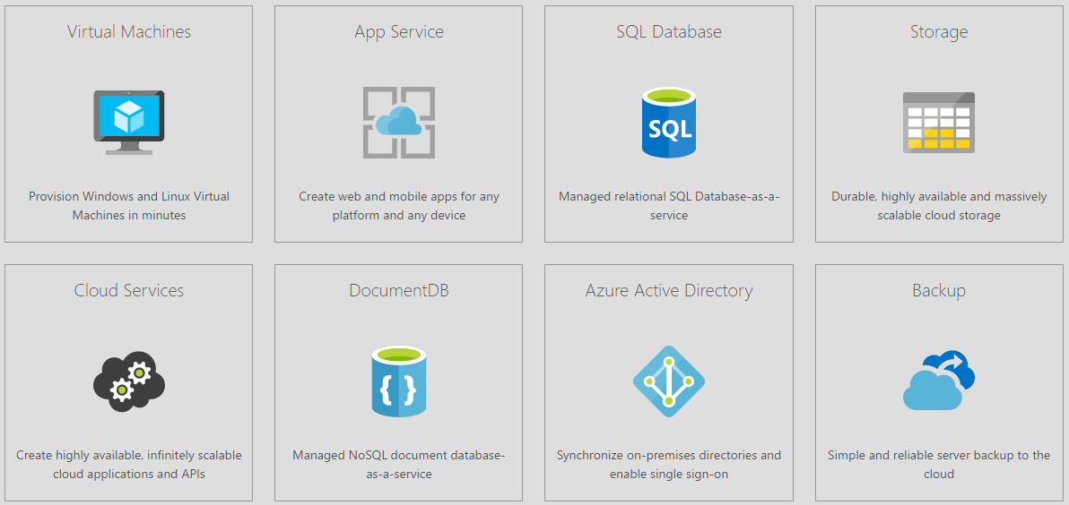
Popular Products in Azure
Notes:
Notes:
The following descriptions are popular services in Azure;
Azure Virtual Machines allows for deployment of a Windows Server or Linux image in the cloud.
Azure App Service lets developers create apps faster with a one-of-a kind cloud service to quickly and easily create enterprise-ready web and mobile apps for any platform or device and deploy them on a scalable and reliable cloud infrastructure.
Azure SQL Database is a relational database service that provides the ability to rapidly create, extend, and scale relational applications into the cloud.
Azure Storage offers non-relational data storage including Blob Storage, Table Storage, Queue Storage, and Files.
Azure Cloud Services removes the need to manage server infrastructure. With web and worker roles, developers can quickly build, deploy, and manage modern applications.
Azure DocumentDB is a fully-managed NoSQL document database service that offers querying and transaction-processing over schema-free data, predictable and reliable performance, and rapid development. NoSQL and SQL DB differences are covered in the next slide.
Azure Active Directory provides identity management and access control for cloud applications. To provide simple user access to cloud applications, on-premises identities can be synchronized and single sign-on can be enabled. Azure Active Directory comes in three versions: Free, Basic, and Premium.
Azure Backup protects Windows client data and shared files and folders. In datacenters integrated with System Center Data Protection Manager (DPM), Backup protects Microsoft SharePoint, Exchange, SQL Server, Hyper-V virtual machines, and other applications.

Slide 17
NoSQL vs. SQL DB
 | NoSQL | SQL
Model | Non-relational – Stores data in JSON documents, key/value pairs, wide column stores, or graphs | Relational – Stores data in a table
Data | Offers flexibility as not every record needs to store the same properties. Good for semi-structured data. | Great for solutions where every record has the same properties. Good for structured data.
Schema | Dynamic or flexible schemas – database is schema-agnostic and the schema is dictated by the application. This allows for agility and highly iterative development. | Strict schema – Schema must be maintained and kept in sync between application and database
Transactions | ACID transaction support varies per solution. | Supports ACID transactions.
Consistency | Consistency varies per solution, some solutions have tunable consistency. | Strong consistency supported.
Scale | Scales well horizontally. | Scales well vertically.
Notes:
Notes:
ACID transactions:
Atomicity: Transactions need to be all or nothing. No partially executed transactions that leave the DB in a incorrect state. For example, in recording for double-entry accounting, the DB can not fail after having recorded the Debit without recording the accompanying Credit. So users must either record both Debit and Credit or do neither.
Consistency: Transaction must bring the DB from one valid state to another, as defined by the rules and constraints of the DB. For example, in recording a Winter sale event, the calculated discounted price cannot be less than the set minimum price for that item.
Isolation: Concurrent execution of transactions results in a system state that would be the same if they were executed serially. For example, calculating the net profit of the company is the same whether calculating the net profits of branch A and branch B simultaneously and summing or by calculating each in turn and summing.
Durability: One a transaction has been committed, it stays committed even in the face of crashes, errors, power loss, etc. For example, once money is withdrawn from an account using an ATM, a sudden power loss doesn’t result in the consumer having more money.
Horizontal Scalability: Adding additional computing resources (i.e., nodes) to the cluster extends its computing power and database storing capability. Horizontal scalability is much cheaper since more nodes just needed to be added to increase capacity.
Vertical Scalability: Adding additional nodes to the cluster does not help. More powerful computers with better computing power and more memory are required. Typically this is a much more expensive proposition.

Slide 18
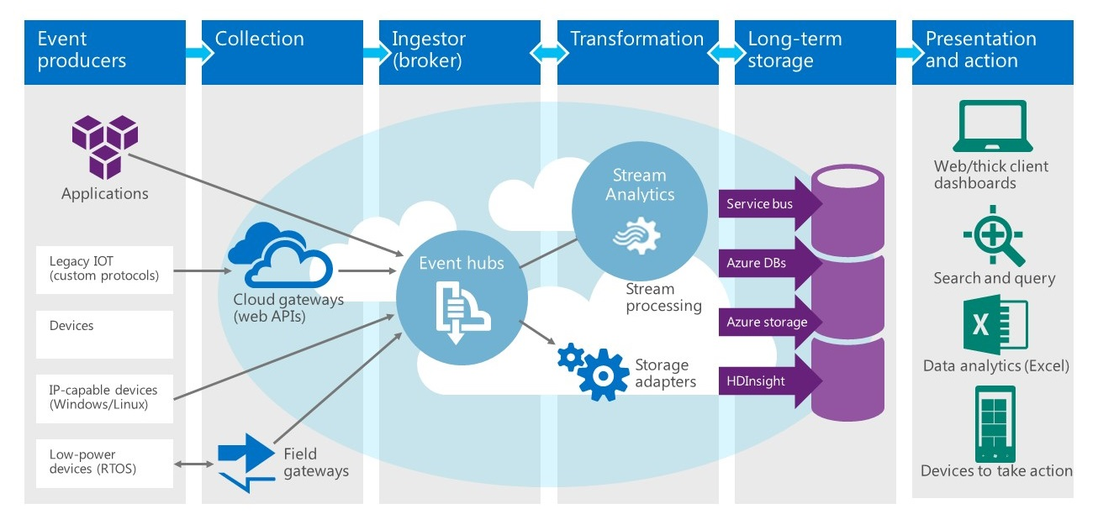
Azure Services Work Together
Notes:
Notes:
This slide shows various components of Azure services that work together to create a total working solution.
References:
Image Source: https://blogs.technet.microsoft.com/dataplatforminsider/2014/10/29/microsoft-adds-iot-streaming-analytics-data-production-and-workflow-services-to-azure/

Slide 19
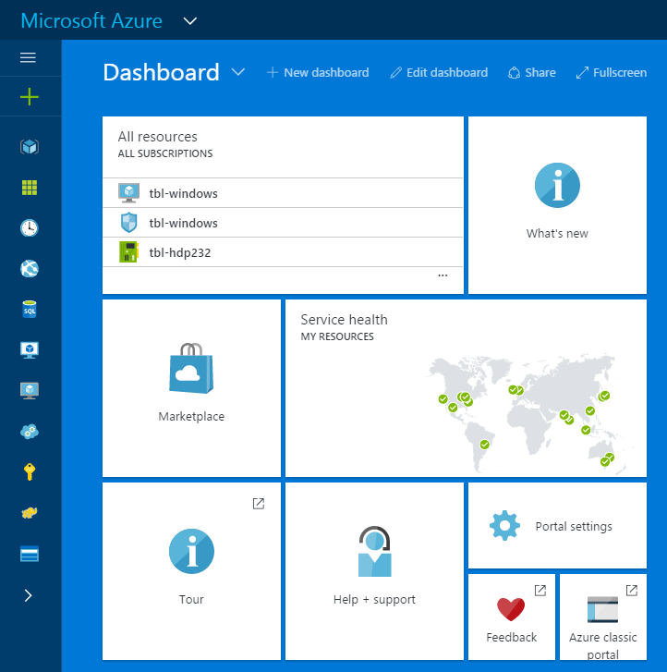
Access Services Through Azure Portal
The Microsoft Azure portal is the central location where Azure resources and services are provisioned and managed
Marketplace for solutions
Customized start screen
Notes:
Notes:
The Azure portal provides a comprehensive marketplace that lets users browse through thousands of items from Microsoft and other vendors that can be purchased and/or provisioned.
The portal provides a unified and scalable browsing experience that makes it easy to find the resources users care about and perform various management operations.
Users can also customize any of the management blades that contain tiles.
References:
https://azure.microsoft.com/en-us/features/azure-portal/

Slide 20
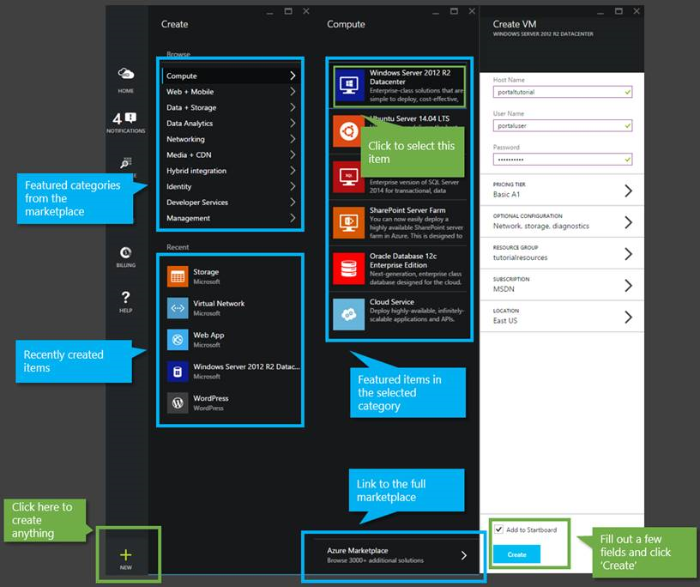
Creating a Resource in Azure Portal
Notes:
Notes:
Students will go through a detailed lab exercise to create resources in Azure.
In this slide, we just want to show that the user interface in the Azure Portal is consistent for all resources.
Choose a resource to provision. This can be chosen from categories or from recently created items.
If a category if chosen, a list of available resources in that category is presented to choose from.
Fill out a few basic pieces information and then click on the create button.
References:
Image Source: https://azure.microsoft.com/en-us/documentation/articles/azure-portal-overview/

Slide 21
Role-Based Access Control in Azure Portal
Azure Role-Based Access Control (RBAC) enables fine-grained access management for Azure.
Built-in roles
Owner has full access to all resources including the right to delegate access to others.
Contributor can create and manage all types of Azure resources but can’t grant access to others.
Reader can view existing Azure resources.
Notes:
Notes:
Using RBAC, duties can be segregated within the DevOps team and while users are granted only the amount of access that they need to perform their jobs.
Each Azure subscription is associated with one Azure Active Directory. Users, groups, and applications from that directory can manage resources in the Azure subscription. These access rights are granted using the Azure portal, Azure command-line tools, and Azure Management APIs.
The RBAC roles assigned to users, groups, and applications dictates what resources can be managed within that scope.

Slide 22
Summary
In this lesson, you have learned:
Key capabilities in Microsoft Azure
Virtual Machines
Cloud Services
App Service
Modules of Azure Service
How Azure portal service is utilized

